Slide 1
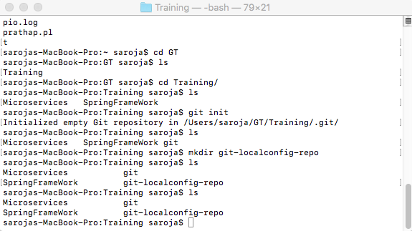

Slide 2
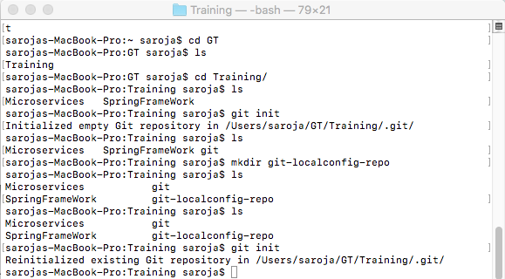

Slide 3
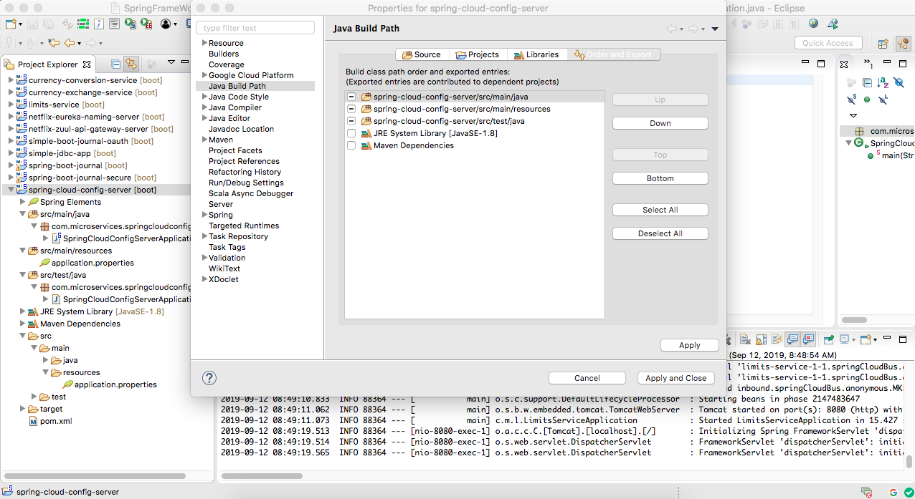

Slide 4
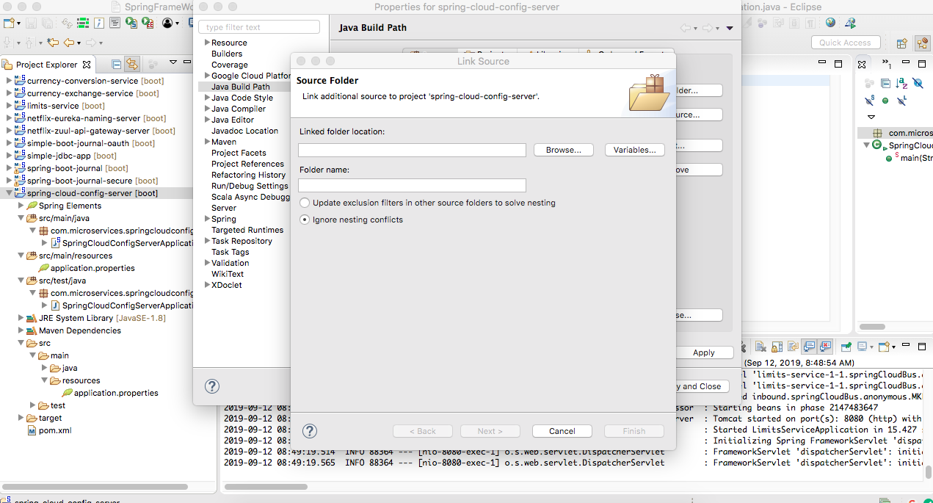

Slide 5
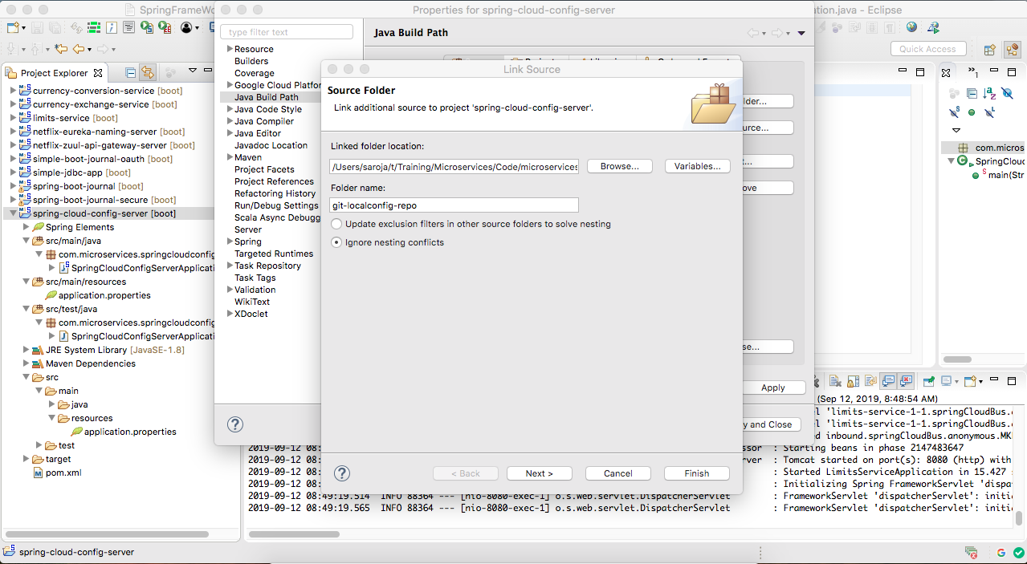

Slide 6
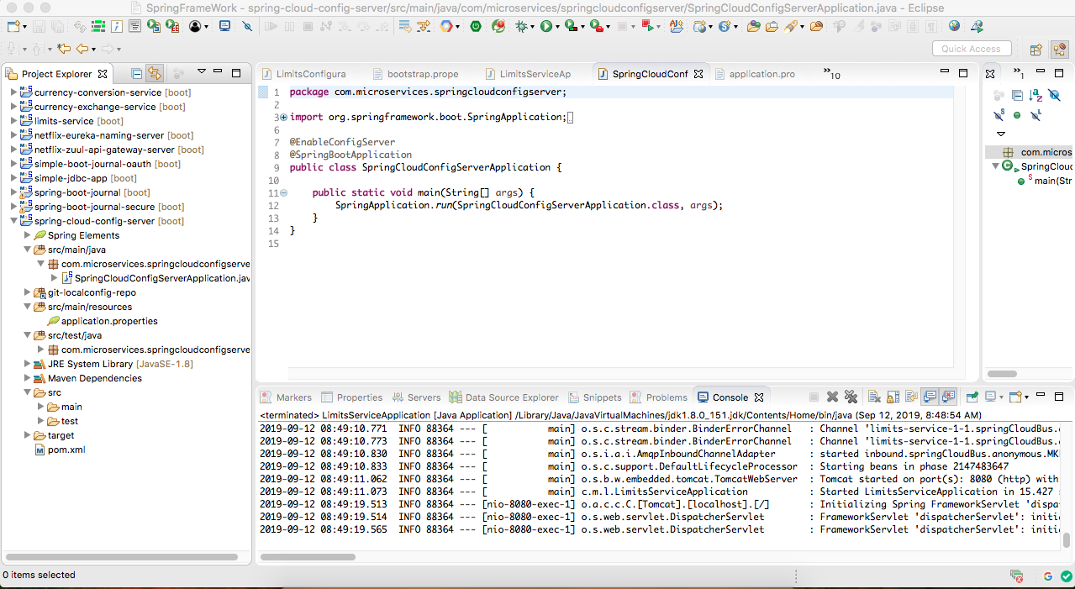

Slide 7
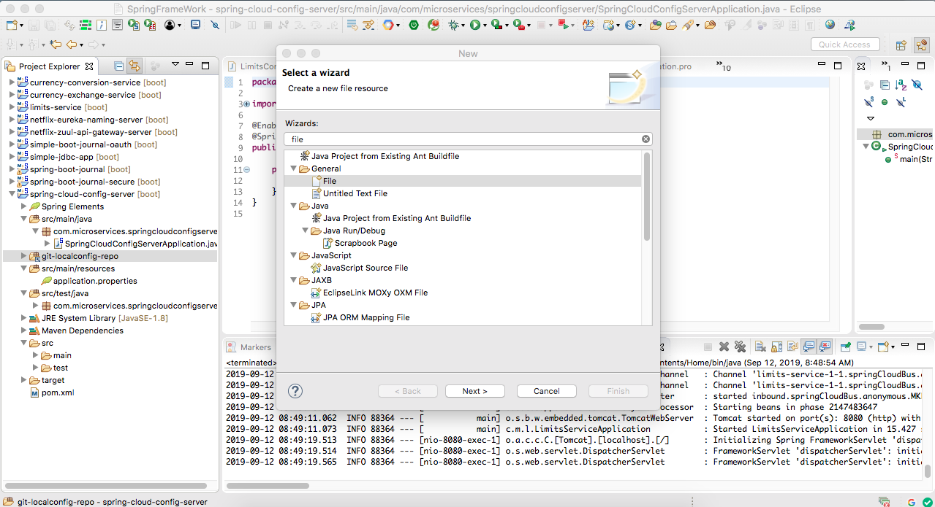

Slide 8
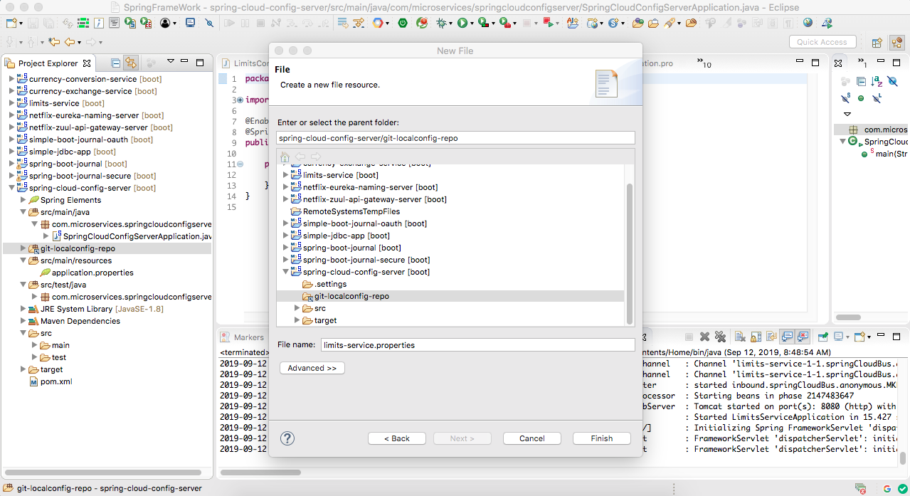

Slide 9
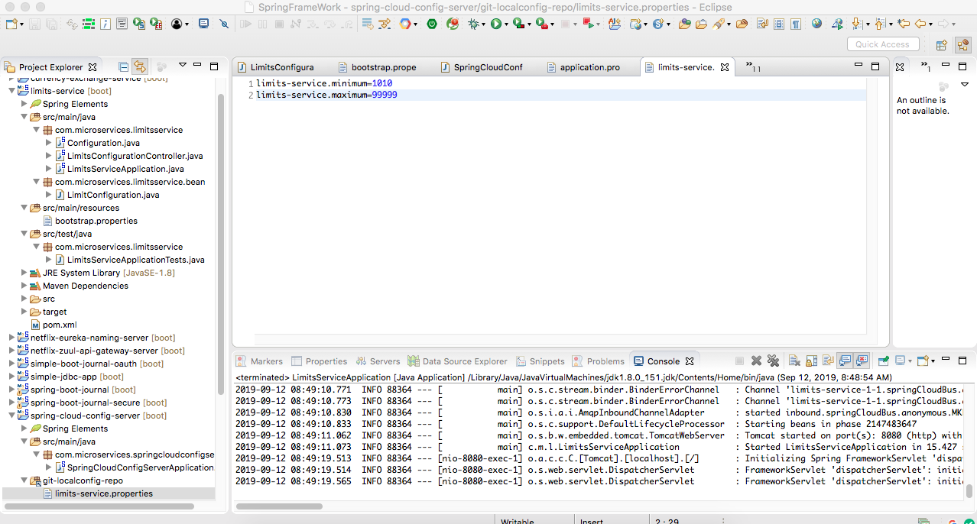

Slide 10
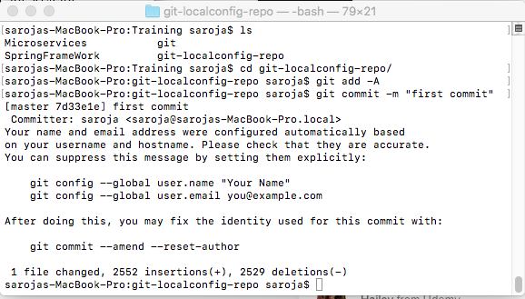

Slide 11
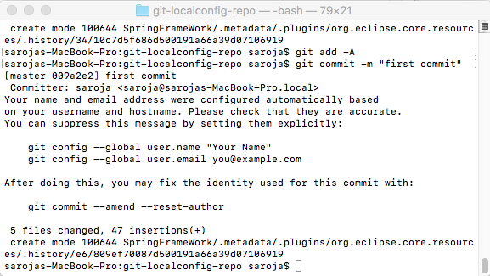

Slide 12
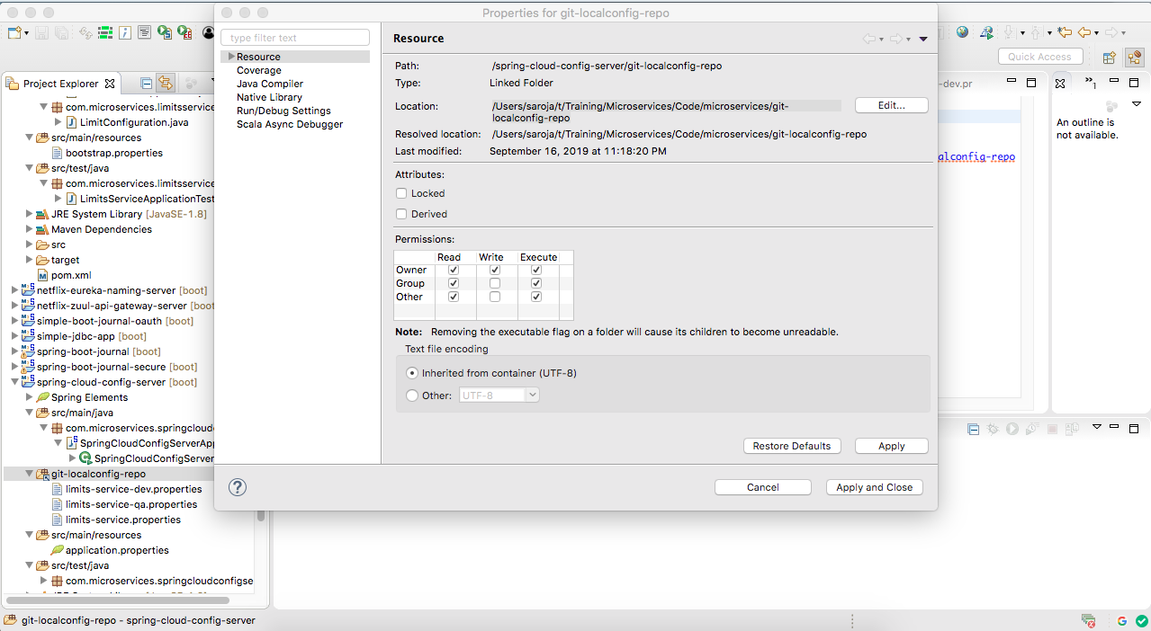
Connect to spring config folder

Slide 13
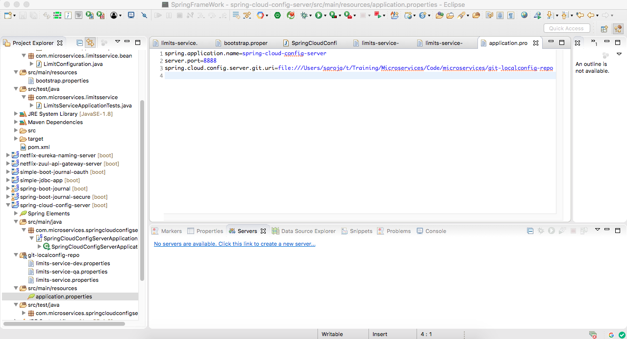
Notes:
(6) If you are on windows, make sure that you are using one of these formats for your git repository
file:\\C:/WORKSPACE/GIT/git-localconfig-repo file:///C:/microservices/git-localconfig-repo file:///C:/Users/Gautham/Documents/workspace-sts-3.9.4.RELEASE/git-localconfig-repo file:\\C:/Users/Gautham/Documents/workspace-sts-3.9.4.RELEASE/git-localconfig-repo

Slide 14
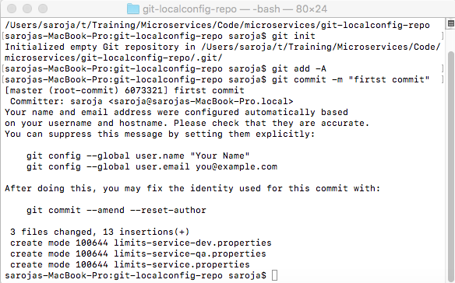

Slide 15
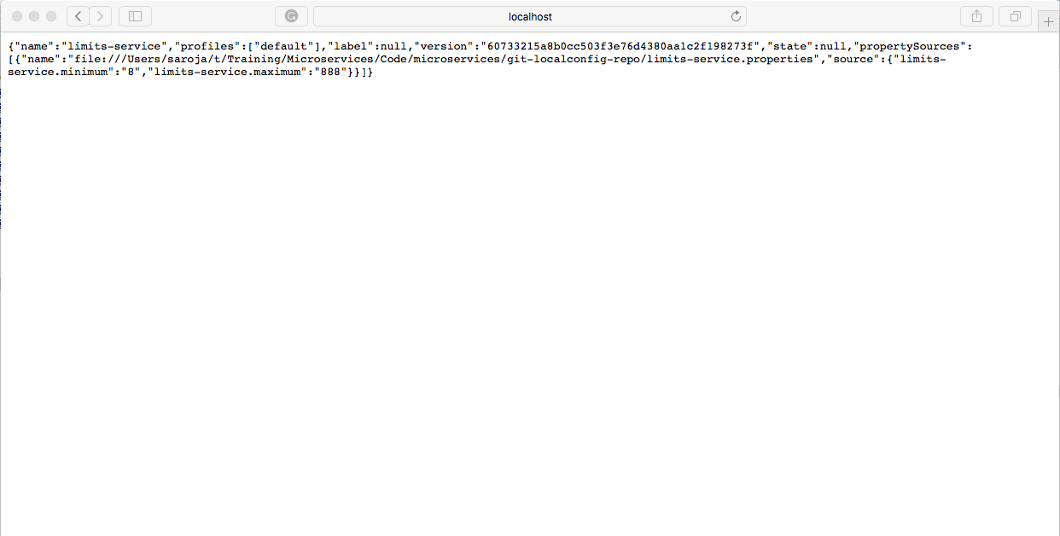
(1) Response for http://localhost:8080/limits
(2) Response for http://localhost:8888/limits-service/default
(3) Response for http://localhost:8888/limits-service/dev

Slide 16
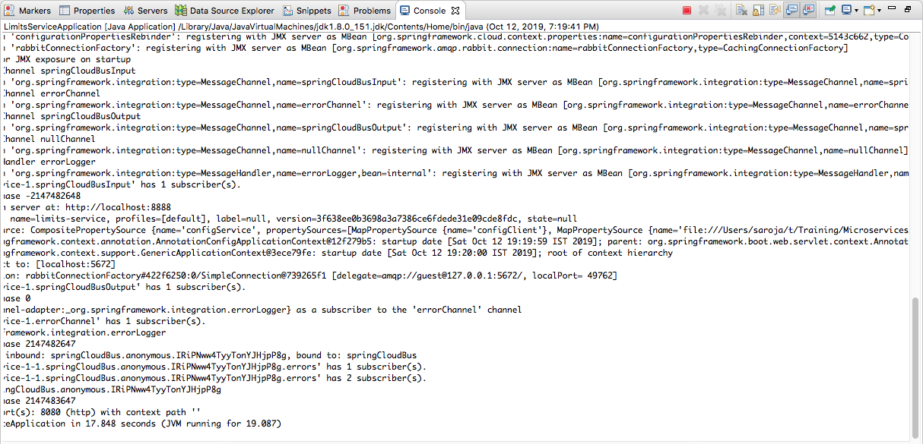
Default Profile

Slide 17
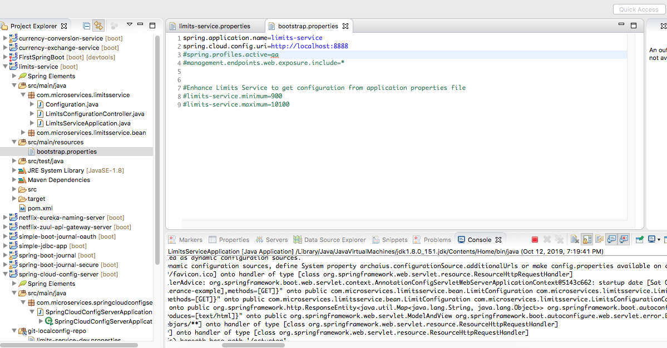

Default Configuaration

Slide 18
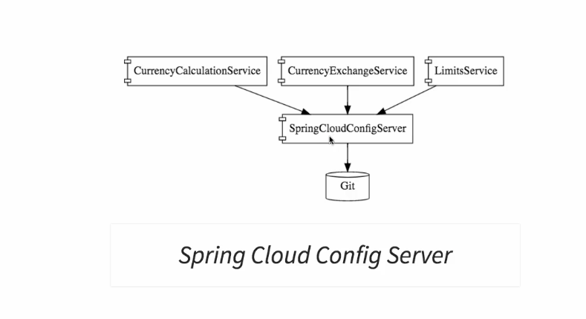
Config Server

Slide 19
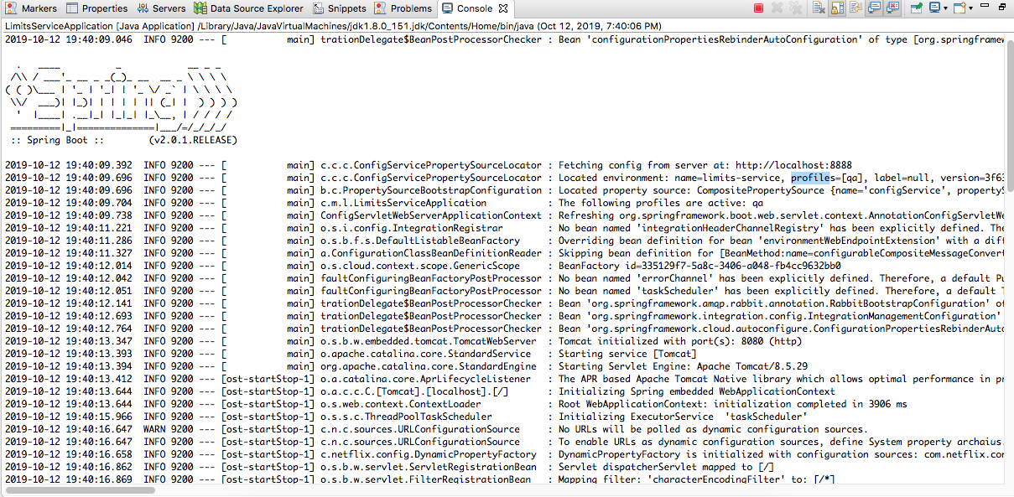

QA Profile

Slide 20
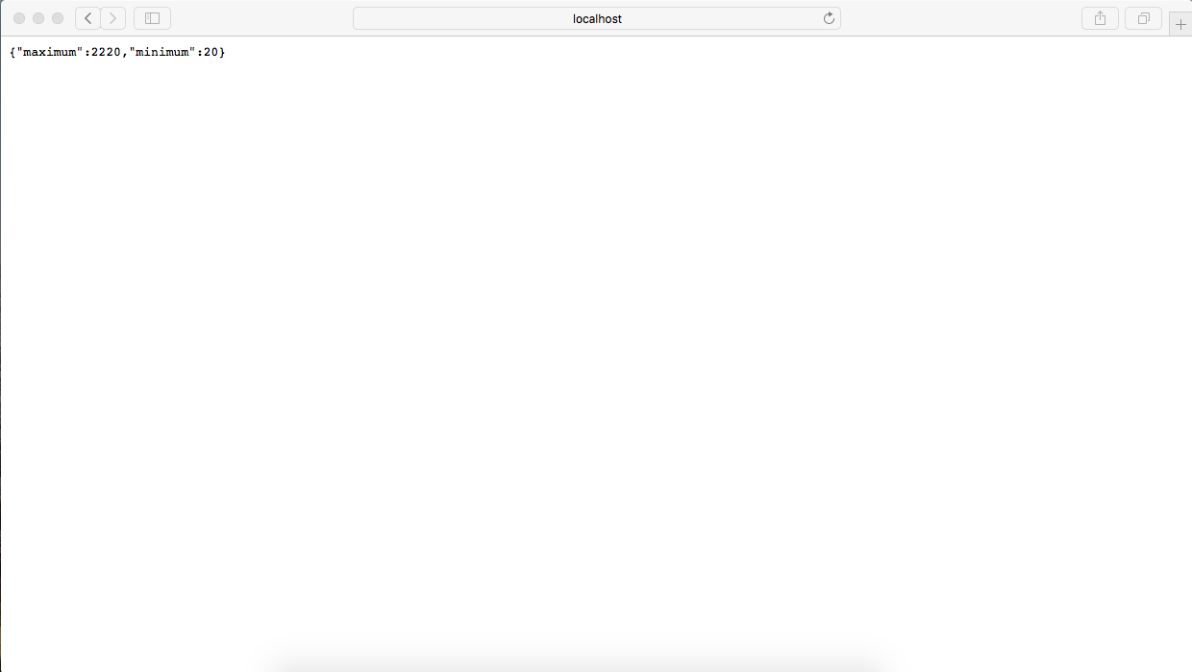
QA Profile Data
http://localhost:8080/limits

Slide 21
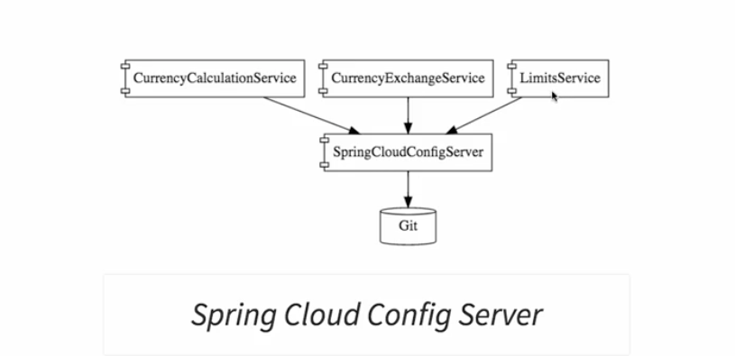

Slide 22
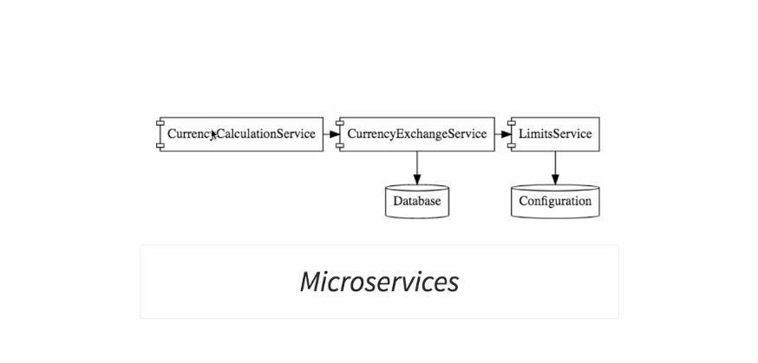
Microservices example architecture

Slide 23
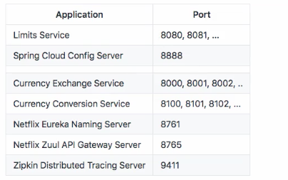
Microservices application ports

Slide 24
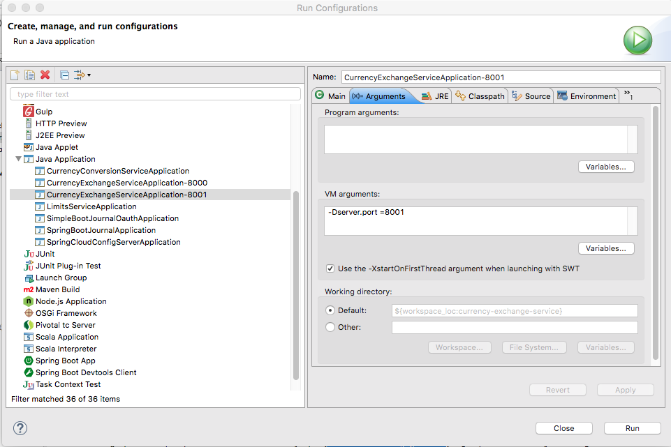
http://localhost:8000/currency-exchange/from/USD/to/INR
http://localhost:8001/currency-exchange/from/USD/to/INR
Setting dynamic port in the response

Slide 25
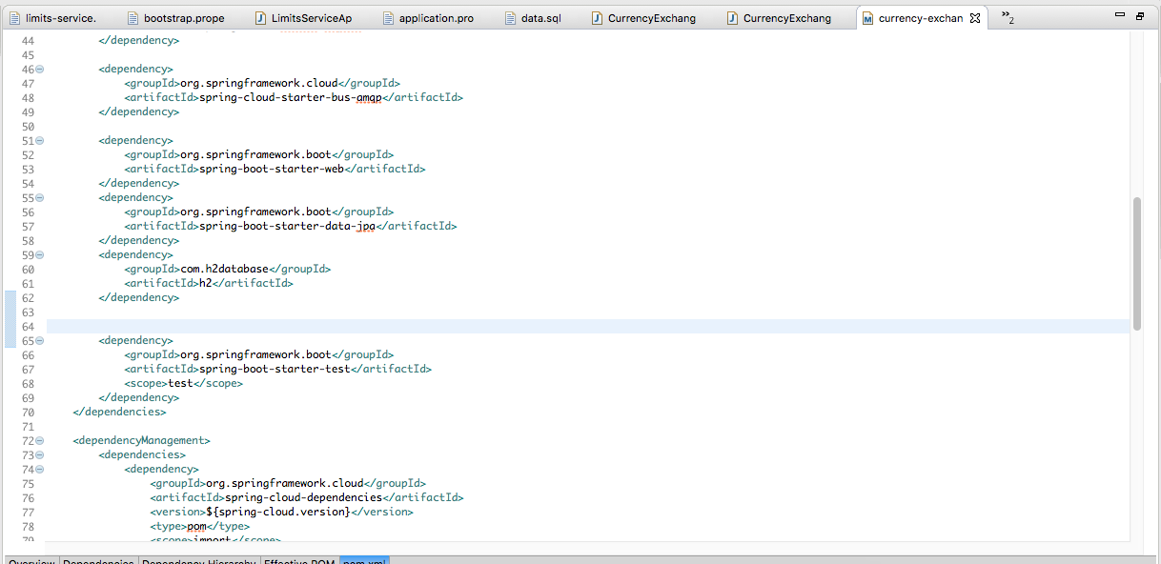
JPA+ H2 Database
Notes:
<dependency>
<groupId>org.springframework.boot</groupId>
<artifactId>spring-boot-starter-data-jpa</artifactId>
</dependency>
<dependency>
<groupId>com.h2database</groupId>
<artifactId>h2</artifactId>
</dependency>

Slide 26
Db Query
To connect to DB http://localhost:8000/h2-console

Slide 27
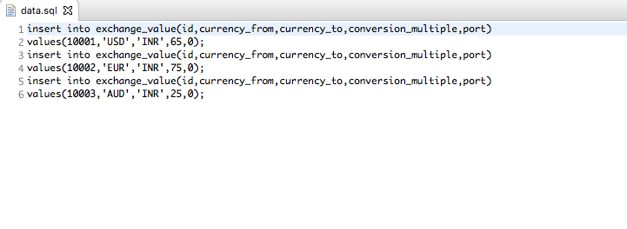

Slide 28
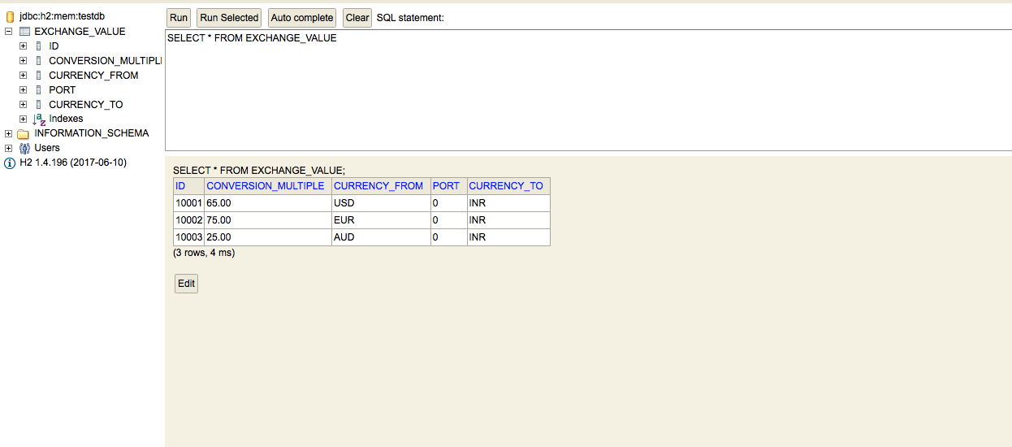
H2 Console

Slide 29
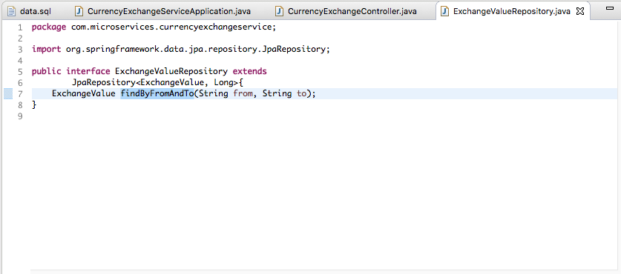
Creating Jpa Repository

Slide 30
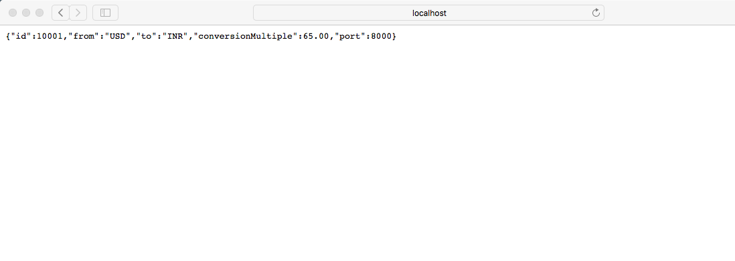
http://localhost:8000/currency-exchange/from/USD/to/INR
http://localhost:8000/currency-exchange/from/EUR/to/INR

Slide 31
Hibernate: select exchangeva0_.id as id1_0_, exchangeva0_.conversion_multiple as conversi2_0_, exchangeva0_.currency_from as currency3_0_, exchangeva0_.port as port4_0_, exchangeva0_.currency_to as currency5_0_ from exchange_value exchangeva0_ where exchangeva0_.currency_from=? and exchangeva0_.currency_to=?
2019-10-13 09:24:04.559 INFO [currency-exchange-service,c31874ecfb1e71c8,c31874ecfb1e71c8,true] 7490 --- [nio-8000-exec-4] c.m.c.CurrencyExchangeController : com.microservices.currencyexchangeservice.ExchangeValue@596361a4
Hibernate: select exchangeva0_.id as id1_0_, exchangeva0_.conversion_multiple as conversi2_0_, exchangeva0_.currency_from as currency3_0_, exchangeva0_.port as port4_0_, exchangeva0_.currency_to as currency5_0_ from exchange_value exchangeva0_ where exchangeva0_.currency_from=? and exchangeva0_.currency_to=?
2019-10-13 09:24:04.718 INFO [currency-exchange-service,28d55acf6c59deab,28d55acf6c59deab,true] 7490 --- [nio-8000-exec-9] c.m.c.CurrencyExchangeController : com.microservices.currencyexchangeservice.ExchangeValue@5aa747e7
2019-10-13 09:24:16.254 INFO [currency-exchange-service,,,] 7490 --- [freshExecutor-0] com.netflix.discovery.DiscoveryClient : Disable delta property : false

Slide 32
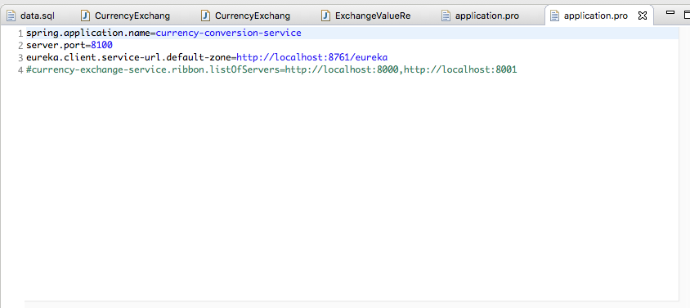
Setting up Currency Conversion Microservices

Slide 33
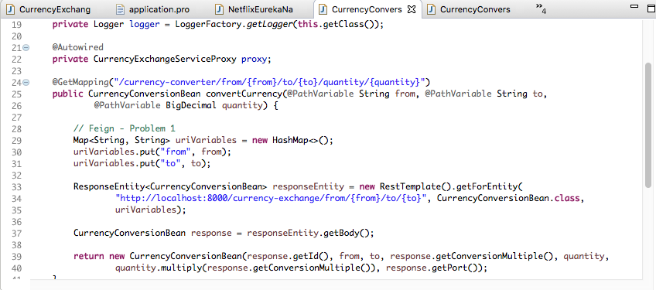
Creating service for currency conversion
Invoking Currecny Exchange Microservice form Currency Conversion

Slide 34
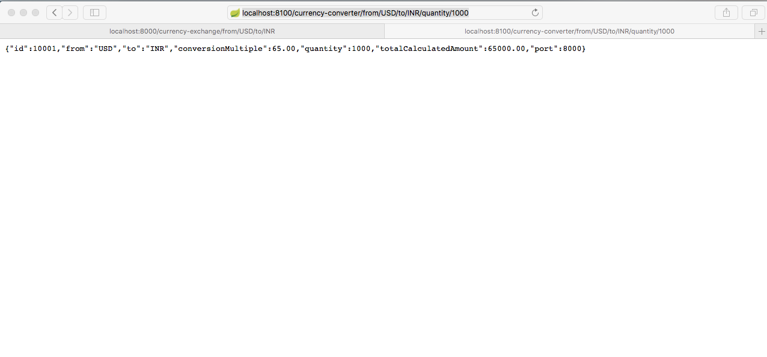
http://localhost:8100/currency-converter/from/USD/to/INR/quantity/1000

Slide 35
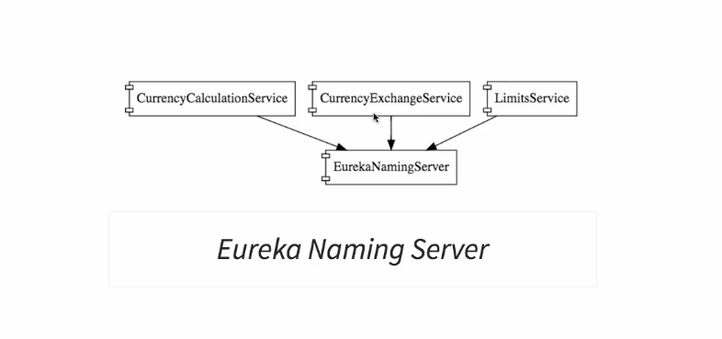
We need the following services to understand Naming Server

Slide 36
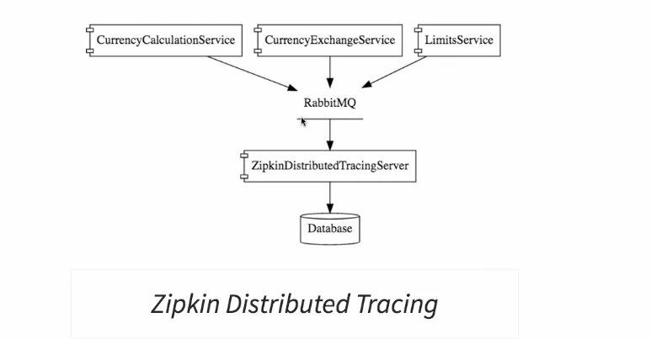

Slide 37
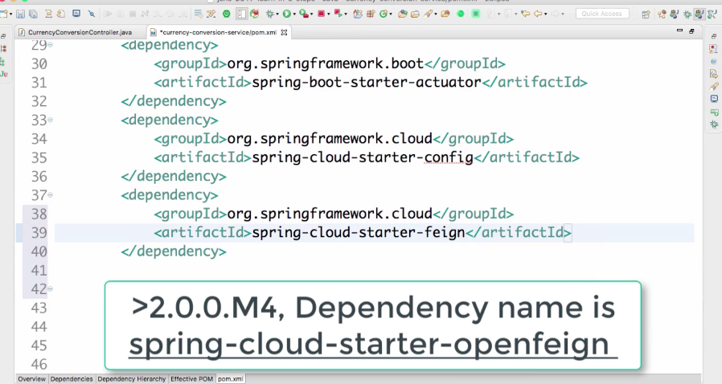
Interservice Dependency With Client side loadbalancing
Notes:
<dependency>
<groupId>org.springframework.cloud</groupId>
<artifactId>spring-cloud-starter-openfeign</artifactId>
</dependency>

Slide 38
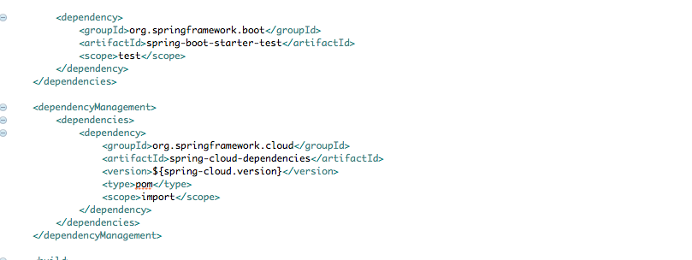
Dependency

Slide 39
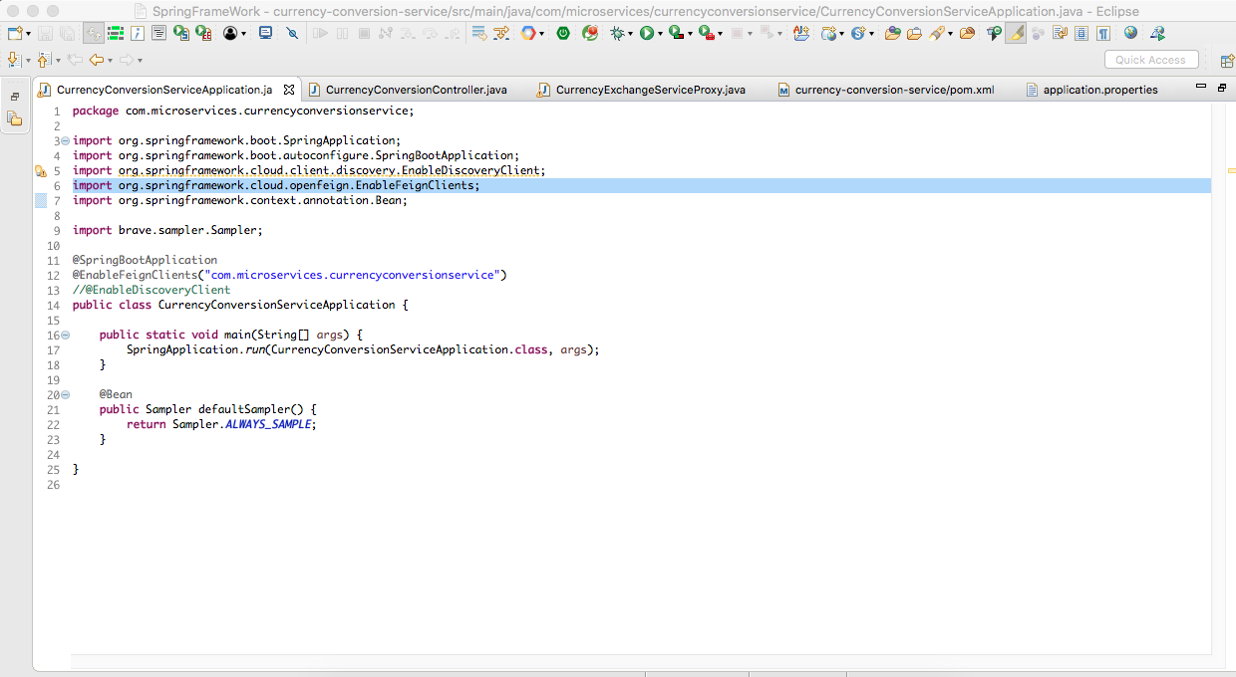
@EnableFeignClients

Slide 40
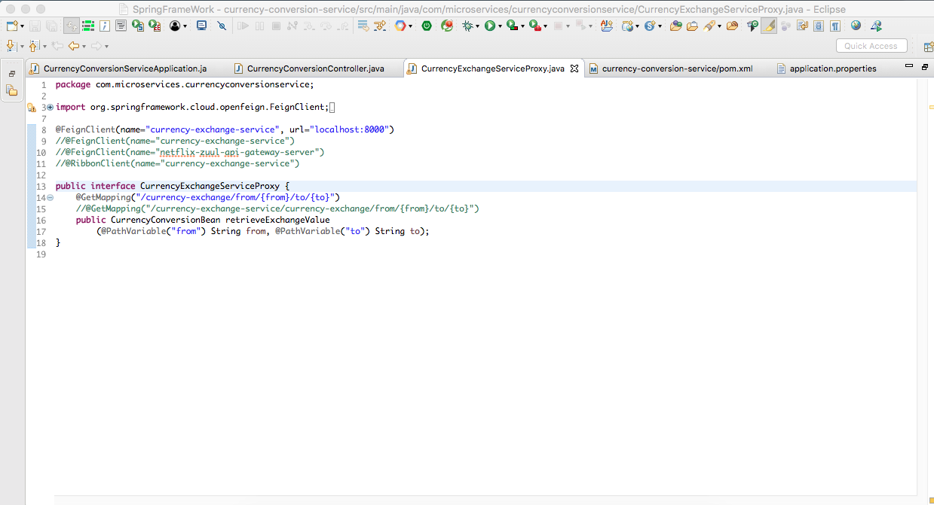
CurrencyExchangeServiceProxy

Slide 41
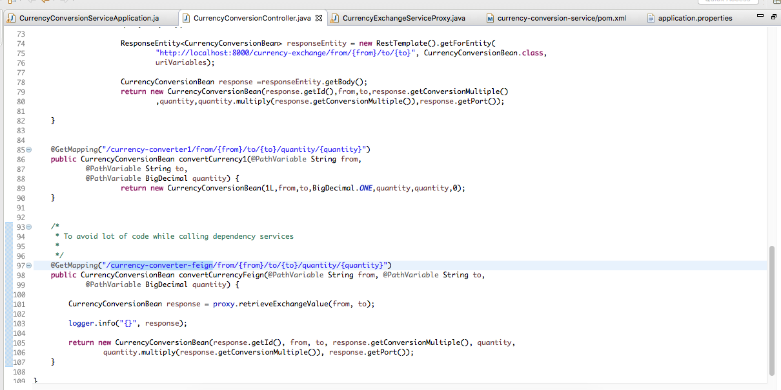
CurrencyConversionController

Slide 42
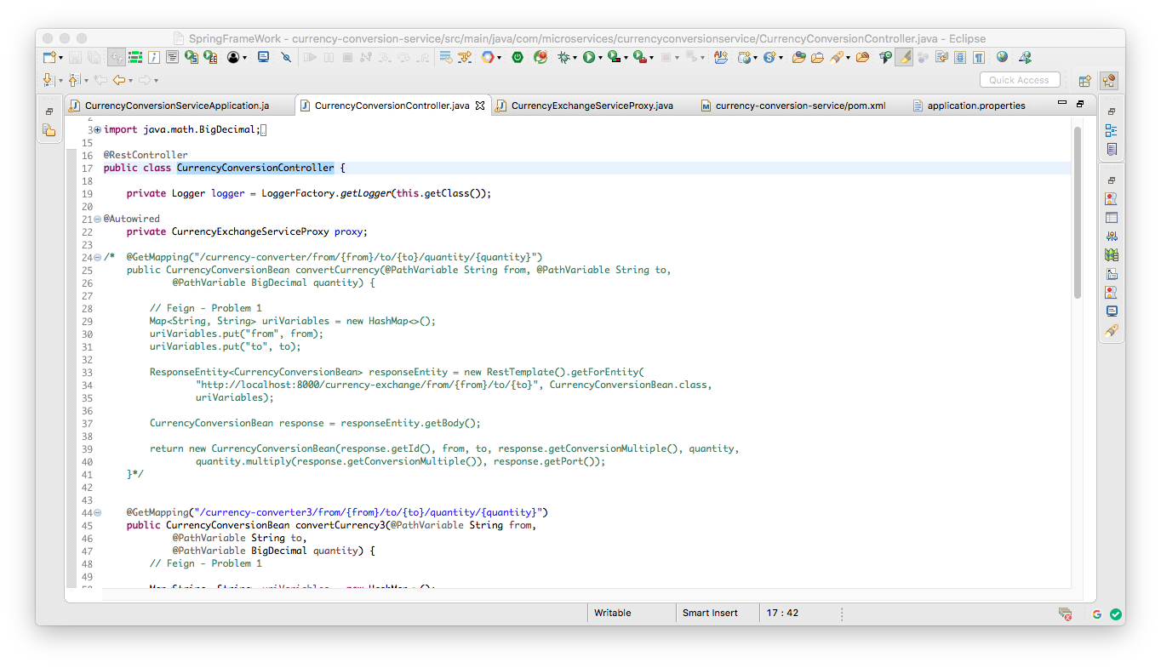
CurrencyExchangeServiceProxy

Slide 43
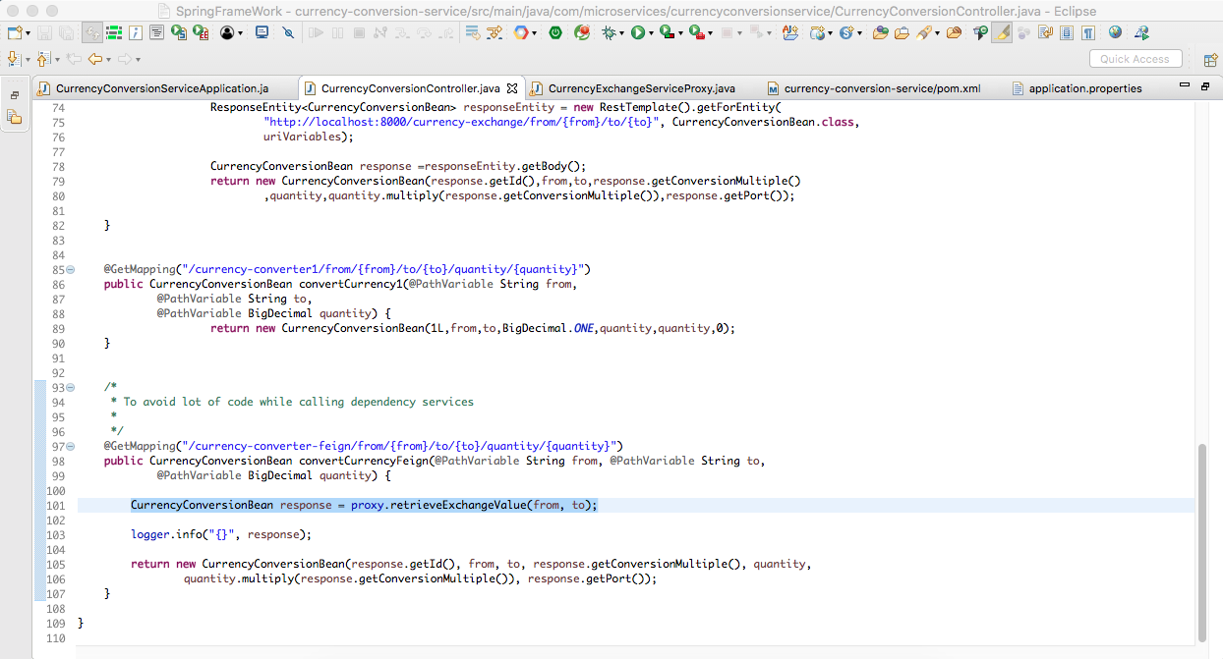
CurrencyConversionBean response = proxy.retrieveExchangeValue(from, to);
Notes:
/Users/saroja/GT/Training/Microservices/Code/microservices/RibbonLoadBalancer

Slide 44
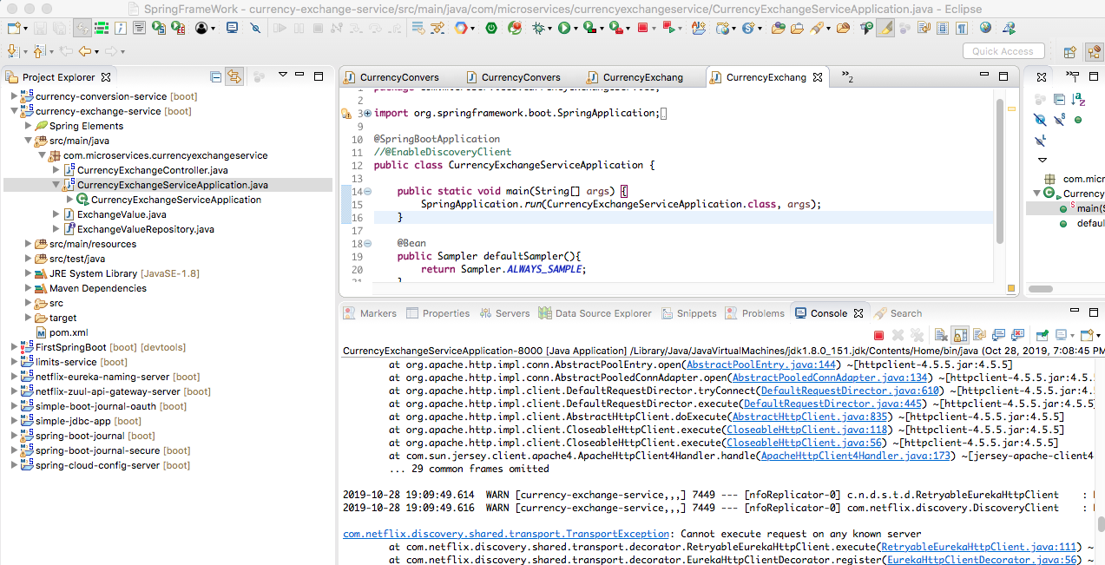

Slide 45
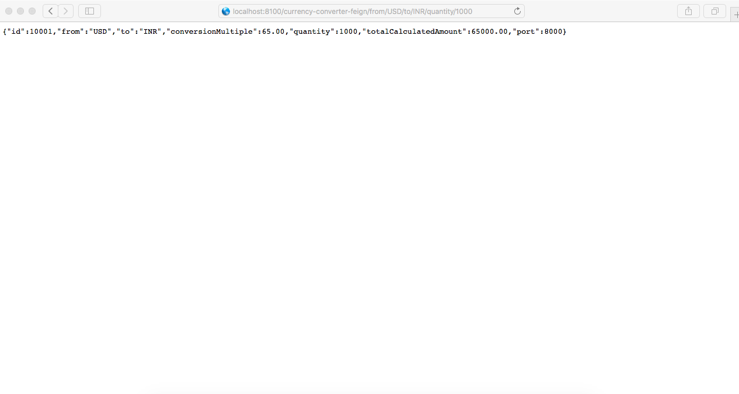
localhost:8100/currency-converter-feign/from/USD/to/INR/quantity/1000
Notes:
http://localhost:8100/currency-converter-feign/from/USD/to/INR/quantity/1000

Slide 46
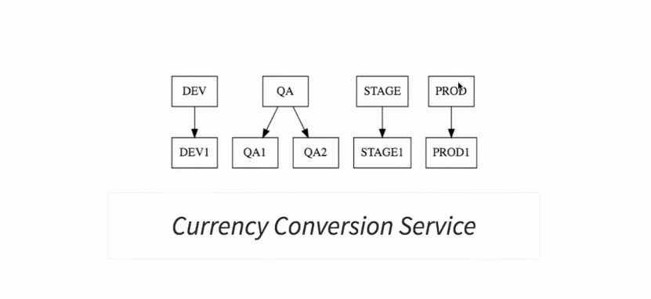
@FeignClient(name="currency-exchange-service", url="localhost:8000")
Notes:
One instance is to be called

Slide 47
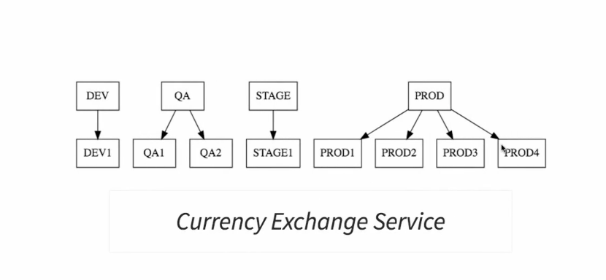
How to handle four instance called Client Side Load Balancing with ribbon
C

Slide 48
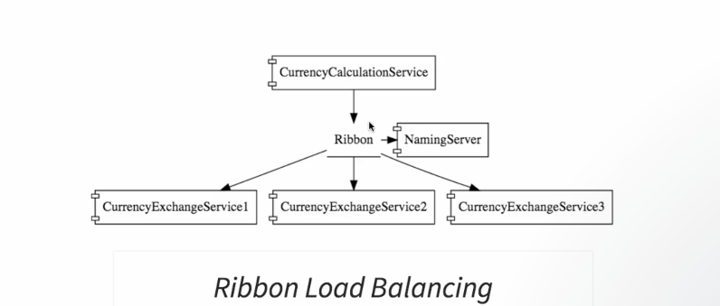
Call all the 3 instance of Currency exchange services
Notes:
One instance is to be called

Slide 49
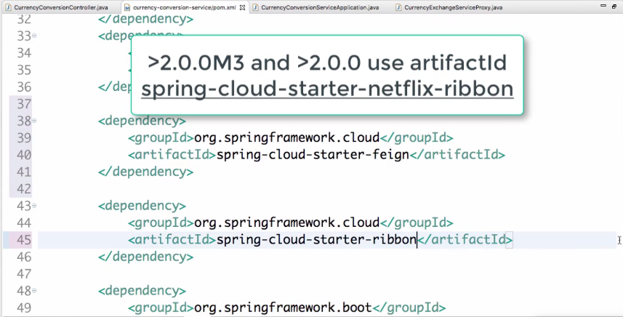
Notes:
One instance is to be called

Slide 50
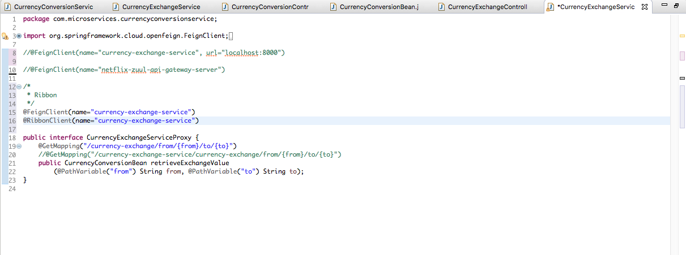
/*
* Ribbon
*/
@FeignClient(name="currency-exchange-service")
@RibbonClient(name="currency-exchange-service")
Notes:
One instance is to be called

Slide 51
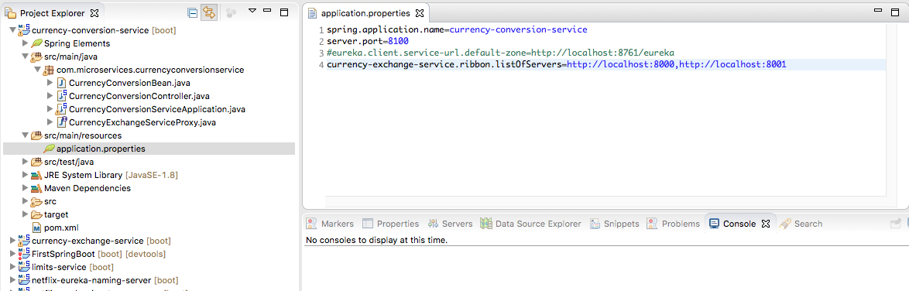
currency-exchange-service.ribbon.listOfServers=http://localhost:8000,http://localhost:8001
Notes:
One instance is to be called

Slide 52
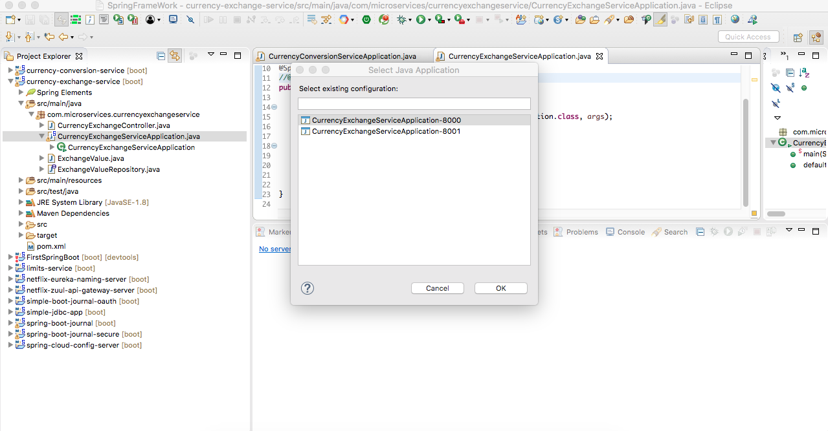
Currency Service Application Running in 2 ports 8000 and 8001
Notes:
One instance is to be called

Slide 53

http://localhost:8001/currency-exchange/from/EUR/to/INR
Notes:
http://localhost:8001/currency-exchange/from/EUR/to/INR

Slide 54

http://localhost:8000/currency-exchange/from/EUR/to/INR
Notes:
One instance is to be called

Slide 55

To understand Load Balancing
Notes:
we configured ribbon we made ribbon distributed the load between two instances
of the currency exchange service.
So what ever service calls are coming from the currency calculation service.
We were able to use ribbon and distribute them between the currency exchange service one and two which were
running on ports eight thousand and eight thousand one respectively.
Let's assume that I would start up another instance of the currency exchange service let's call it currency
exchange service 3 and launch it up on eight thousand two will ribbon be able to distribute the load.
To it with things as they stand right now.
Think about it thing is if I would want ribbon to distribute the load to the new server I would need to add
it to the configuration.
So I would need to change my application configuration whenever a new server is created.
And that's not really good.
What I would want to be able to do is based on the load I would want to be able to increase and
decrease the number of instances of these services.
So I would want to be able to dynamically increase the currency exchange services or decrease them if
I have to keep on changing the configuration of currency calculations service based on how many currency
exchange services are active right.
Then it becomes very very difficult maintenance headache.
That's where the name services come in.
If the currency exchange service is running on a URL xyz you don't want to hardcoded on
the currency calculation service because there might be a new instance of the currency exchange service
coming up or the existing instance might be going down and things like that rather than that we have
something called namings server.
All the instances of all micro services would register with the naming server.
Whenever an instance of a micro service comes up it would register itself Eureka naming
service this is called Service registration.
And whenever a service wants to talk to another service let's said the currency calculation Service wants to talk
to the currency exchange service what would it do.
It would talk to the name server and it would ask the name server what are the instances of the currency
exchange service that are currently running.
This is called.
Service discovery.
So the currency calculation Service is asking for the location of the currency exchange service the instances
of currency exchange service that is called service discovery.
The two important features of the naming server are service registration and service discovery at startup
of every application they would register with the naming server and whenever they want details of another
micro service they would a service discovery they'll say I want the details of service X Y Z.
Can you give me the details in the next step.
We would set up a naming server and have currency calculation service and the currency exchange service

Slide 56
To understand Load Balancing
Notes:
Before we would be able to use the naming server there a lot of steps that are involved.
The first thing is we would want to create a component for the Eureka naming server the second thing
is we would need to update the currency calculation service to connect the Eureka naming server the third
thing that's we would want to connect the currency exchange application also to talk to the Eureka naming
server.
The last thing we would do is configure ribbon.
Ribbon is actually currently installed in the currency calculation service.
Once the currency exchange service instances register with the naming server.
We would then use the ribbon to find those details from the naming server.
That would be the last step before we would be able to use the naming.
server let's get started with the first step.
That is to create the component for the naming server.
There are a number of other options present for naming servers.
But Eureka is one of the famous one which are offered by Netflix.

Slide 57
To understand Load Balancing
Notes:
Before we would be able to use the naming server there a lot of steps that are involved.
The first thing is we would want to create a component for the Eureka naming server the second thing
is we would need to update the currency calculation service to connect the Eureka naming server the third
thing that's we would want to connect the currency exchange application also to talk to the Eureka naming
server.
The last thing we would do is configure ribbon.
Ribbon is actually currently installed in the currency calculation service.
Once the currency exchange service instances register with the naming server.
We would then use the ribbon to find those details from the naming server.
That would be the last step before we would be able to use the naming.
server let's get started with the first step.
That is to create the component for the naming server.
There are a number of other options present for naming servers.
But Eureka is one of the famous one which are offered by Netflix.

Slide 58

Aplloication properties Naming Server

Slide 59

pom.xml Server
Notes:
<dependency>
<groupId>org.springframework.cloud</groupId>
<artifactId>spring-cloud-starter-netflix-eureka-server</artifactId>
</dependency>

Slide 60

pom.xml Client
Notes:
<dependency>
<groupId>org.springframework.cloud</groupId>
<artifactId>spring-cloud-starter-netflix-eureka-client</artifactId>
</dependency>

Slide 61

@EnableEurekaServer

Slide 62

@EnableDiscoveryClient

Slide 63

Naming Server http://localhost:8761
8761
Notes:
You'd see that the Netflix Eureka naming server is coming in here as usual we would see source main java resources test
Java and the Maven dependencies.
Open up the Netflix Eureka naming server application class to enable the Eureka server you would need to
add in another
annotation it's enable Eureka.
Server I would import the annotation in and other than that I would want to open up the application dot properties
and quickly configure the name and other stuff.
Spring dot application dot name is equal to I would copy the artifact ID which we have given in here.
Netflix Eureka naming sever the port.
We want to use here is 8 7 6 1.
This is typically the default port for the naming server.
For now I don't want the server itself to register with the naming server I'll Eureka dot client dot.
Register with the Eureka I'll make it false and say it was the case with fetching a registry I don't
want to do that right now.
So let's disable that as well.
So this is a very simple configuration right.
We are giving it an application name configuring a couple of settings and configuring a port name
for it.
Once we are done with this you can actually launch the Eureka naming server application as the java application
Right-Click run as java application.
You would see that the Eureka server launched up Langella find it's URL 8761.
Let's go to the browser and hit the URL localhost Colan 8 7 6 1.
You can see the Eureka.
Server the UI for it present it in here you can see a high level status of the system here.
And also you can actually see the instances we check currently registered with the Eureka in
here.
Right now we don't really have anything.
Register with the Eureka server.
Now what we have now is the Eureka naming server is up and running.
How ever the currency calculations servies and the currency exchange service are not yet registered with the Eureka server.
Let's fix that in the next step in this step.
What we did was to create a new component for the.
Eureka server and we enable Eureka server by adding an at enable Eureka.
Server annotation on the application find as well as configured the name and port for the eureka server
and configured a couple of properties.
That's all we had to do to get the Eureka server up and running in the next step.

Slide 64

Eureka server Log
Notes:
we set up the Eureka Naming Server. In this step, we will connect the Currency Calculation Service
and the Currency Exchange Service to the Eureka Naming
Server. I'll start with the Currency Conversion Service.
So, I'll go to the pom.xml
and I would want it to connect to be Eureka server. To be able to do that, I'd need to add a dependency to this.
As usual, it's a very simple dependency, starter-
Do you want to guess? Yup, eureka. You need to add that, wait for the workspace to build, and
in the meanwhile, what I would do is, I would open up the Currency Conversion Service application
and over here, I would need to add another very simple annotation. What we would want the Currency Conversion
Service application to do is to register with the naming server and to be able to do that, we'd need tp
add annotation @EnableDiscoveryClinet.
You can organize the imports.
That's the only specific thing that is present. So, it's easy to import it in, @EnableDiscoveryClinet. Now,
once you have enabled the discovery client, I'd
need to configure the URL for Eureka.
I would open the application.properties for the Currency Conversion Service and configure the URL
for Eureka in here. The URL for Eureka that we'd need to configure is localhost:8761/eureka
and the property is eureka.client.service-url.defaultZone, default-zone is equal to the URL of the
Eureka server.
If you look at the Eureka server right now, you'd see that there are no instances registered with
Eureka.
You can see that there are no instances available.
Now, let's go ahead and launch up our favorite application. The Currency Conversion application, we are launching
it up on 8100.
You'd see that there would be a little more log at the launch up. What the Currency Conversion
Service
does is, at launch up, as soon as the application is up, it would register itself with the naming server,
with the Eureka naming server. That's the log that you're seeing with all the discovery client, that's discovery
client stuff that's going on in here. You can see that it's registering with the discovery client and what
response is coming back.
If I actually go to the Eureka server and refresh, you'd see at the bottom of the screen right now
that Currency Conversion Service is registered with it and an instance is running on 8100. One of the exercises
you can try is to bring up another instance of the Currency Conversion
Service on 8101 and see if it registers in here.
We have the Currency Calculation Service connecting to the Eureka Naming
Server. The next step is to connect the Currency Exchange
Service to the Eureka Naming Server as well.

Slide 65

Notes:
In the section on micro services until now we have created three simple micro services currency calculation
service the currency exchange service and the limits.
Service typically in a micro services architecture you'd have 100 of my services that are talking to
each other and there are common features that we would need to implement for all these micro services.
You would want to make sure that every call to every micro service is authenticated.
A check is done on the authorization whether the user has the right permissions.
You also want to implement things like rate limit for a specific client.
You would only want to allow certain number of calls per hour or per day they might be limits like that
present you'd want all these micro services to be fault tolerant if there is a service that I am depended
on and it's not up I should be able to give some default response back and in a typical micro service
environment they should also be some kind of service aggregation that should be provided.
Let's say there is an external consumer who wants to call 15 different services as part of one process.
It's better to aggregate those 15 services and provide one service call for the external consumer.
So these are kinds of features that are common across all the micro services and these are features
which are implemented at the level of API gateways instead of allowing micro services to call each other directly
what we will do is we would make all the calls go through a API gateway and the API gateway would take
care of providing common features like authentication making sure that all service calls are logged making
sure that the rate limits are at the two and making sure that these services are fault.
tolerence.
The API gateways can also provide aggregation services around multiple services because all calls get routed
through the API gateways it a gateways.
Also as a great place for debugging as well as doing analytics

Slide 66

Notes:
You said we would want to intercept all calls between all micro services and have them pass through
API gateway.
Netflix provides an implementation called Zuul.
There are three steps to setting up a zuul server.
number one is create a component for it.
So we would want to create a component for these zuul API gateways server the second thing is to decide what
should it do when it intercepts a request.
So when a currency calculation service is called to currency exchange services intercepted what should
this Zuul API gateway do you need to implement that.
That's the second part the third part is to make sure that all the important requests are configured
to pass through.
The Zuul API gateway.
The first part is to set the component of the second part is to decide what things that the Zuul API should
do when it intercepts a request.
The third part is to make sure that the right requests go through this Zuul API.
Let's get started with the first part that basically setting up a Zuul API gateway server as usual.

Slide 67

Notes:
implemented in the API gateway things like authentication authorization rate limits.
Service Aggregation fault tolerance logging these are typically the things which are typically implemented
in the API gateways.
We have the Zuul server.
ready to act as the API gateway.
And now we would want to implement some functionality in there.
What we'll do in this step is we would add some logging to the Zuul API gateway.
So what we'll do is any request that comes through the gateway.
What we'll log it.
Let's implement that during this step.
I'm opening eclipse and I'm in the Netflix Zuul API gateway server project and I would want to create
a new Java class new class.
I would say next I'll want to call the Zuui logging filter and say finish I'd want spring to manage this I'll say at component.
And also a Zuul filter should implement a specific class.
So it should extend a specific class which is Zuul filter let's organize the imports at component is imported
in Zuul filter is imported in.
If Let's look at this.
Zuul filter as you can see something from Netflix com Netflix Zuul Zuul core Zuul log in filter I can press control
One there is a compilation error because there are some abstract method which are present in this Zuul
filter which we would need to implement.
So what I do is add and implemented methods if you add and unimplemented methods you would get the default
implementations for all the abstract methods inside the Zuul filter so I'll remove the tools which are present
in here.
Control D command D.
And there are four important methods which are present in here should filter run filter type and filter
order.
Lets start with the filter order.
If you have multiple filters so lets say you have a Zuul logging filter Zuul security filter and a lot
of other filters you can set a priority order between them.
So you can give a priority order of one for these two for the other one and three for the other one
and so on.
So return a one down here.
So the filter order we are sitting for this one the second one is should this filter be executed or not.
You can actually implement business logic so you can check the request and see certain things and decide
if you would want to execute the filter or not.
For now we would want to execute this filter for every request.
So I will return true for should.
Filter the other method which is present in here is filter type the filter type is to when should the filtering.
Should filter be happening before the request is executed or after the request has executed.
Or do you want to filter only error requests that have caused an exception to happen in this specific
example.
What we want to do is we would want to intercept all the requests before execution so I'll say pre filter type
we would want to this pre.
Here is where the real logic of the interception goes.
I'll leave the return I'll in here and implement the complete logic in here.
Line 28 ******************-------********************************
So what I would want to log is the details of the request.
So how do I get the current request.
I can say request context dot get current context dot get request.
This would give me the current HTTP request which is being handled I'll assign it to a local variable.
Just call this request that's cool.
What I would want to do is to log some of the information from this request so I would need a log object
so I will create a logger in here.
A private logger logger is equal to logger factory dot get logger and I would say this get class let's organize the imports.
I would want to use the SLF4J logger.
And now I'm ready to use the logger.
So what I would want to print is some of the details of the request right.
So I would say logger dot info and say request is this.
And I'll also want to print that request URI request.
URI is this.
Let's pass the perameters in does in request comma request dot get a request.
URI.
If you look at the HTTP servlet request there are a lot of other methods which it offers.
So if you want log other information feel free to do so and keeping it very simple and I'm just logging in.
Couple of things from the request.
That's it.
We have a logging filter ready in the next step.
We will understand how to execute requests through the Zuul API proxy in this step.
What we have done is very simple right.
We wrote simple Zuul logging filter.
The most important method that we have implemented is just to log the content of the request the thing is
in Zuul.
You can do a lot more than just logging the request if you want to implement security.
Or if you'd want to implement rate limiting this would be a great way to implement t

Slide 68
Implement Zull for currency exchange server
This is the conventional way to hit the service with out ZUUL
http://localhost:8000/currency-exchange/from/EUR/to/INR
Zull implementation of the url
http://localhost:8765/{application-name}/{uri}
http://localhost:8765/currency-exchange-service
currency-exchange/from/EUR/to/INR
Notes:
These are all registered with Eureka.
That's cool the way we typically invoke the currency exchange service.
Is just typing in localhost 8000 currency exchange from EUR to INR. http://localhost:8000/currency-exchange/from/EUR/to/INR
2019-12-20 22:17:23.207 INFO 37520 --- [nio-8765-exec-4] c.m.n.ZuulLoggingFilter : request -> org.springframework.cloud.netflix.zuul.filters.pre.Servlet30RequestWrapper@6ddecf06 request uri -> /currency-exchange-service/currency-exchange/from/EUR/to/INR

Slide 69

http://localhost:8765/currency-exchange-service/currency-exchange/from/EUR/to/INR
Notes:
One instance is to be called

Slide 70





Notes:
So I'm sending the request to the API gateway instead of directly calling the micro services.
Now what's happening on the API gateway let's see.
So this is the log for the Netflix Zuul API gateway server application.
You could see that the content of the request is printed on this Zuul API gateway server you can see that
the request is printed.
The request URI is also being printed in here.
So it says currency exchange service currency exchange from EUR.
To INR in this step we executed a request through the API gateway

Slide 71
Url to access from ZUUL
http://localhost:8765/currency-exchange-service/currency-exchange/from/EUR/to/INR
http://localhost:8000/currency-exchange/from/EUR/to/INR
http://localhost:8100/currency-converter-feign/from/USD/to/INR/quantity/10
http://localhost:8764/currency-conversion-service/{uri}
http://localhost:8100/currency-converter/from/USD/to/INR/quantity/10
http://localhost:8100/currency-converter-feign/from/USD/to/INR/quantity/10
Notes:
One instance is to be called

Slide 72

http://localhost:8765/currency-exchange-service/currency-exchange/from/EUR/to/INR
Through Netflix zull currency-exchange-service
Notes:
This is the port for the API proxies so Gateway proxies running on 8765 and we use the proxy to execute
the currency exchange service what we want to do now is when the currency calculation Service is calling
the currency exchange service.
We don't want the call to happen directly we would want the call to go through the API gateway that's basically
Zuul server.
So how do we get the currency calculation service the request from here to go through the Zuul API gateway proxy thing which
actually makes the call inside the currency conversion service is the proxy the currency exchange service
proxy.
The thing is we already configured the naming server.
The thing is all the important things that we use are registered with the naming server.
Number one the Exchange service is the currency exchange service is register the currency conversion.
Service is registered this Zuul API gateway also switches.
So all that we need to do here is I would need to say OK do not connect to the currency exchange service
feign connect to the Zuul API proxy.
I would want to get the application name for it.
So I'll say application dot properties I would want Zuul API gateway servers name.
I'll use this feign client.
You need to make a call to Netflix Zuul API gateway.
Server talk to the naming server and get the URI for it.
That's cool.
So now it would go through the API.
Server However there is another thing that we would need to change.
The thing is URI no longer currency exchange from EUR to INR.
There is something else that needs to be appended to this.
So you need to append the name of the application which is exposing that service so would need to append in currency
exchange service to the
URI.
So let's go to the service proxy in the get mapping append that stuff in.
So I'm appending currency exchange service coming this out and I'll copy it again so that we have a history of
what we are doing in here present.
So that's basically what we have right now.
So currency exchange service.
Now I can save this you can see that the currency conversion service application is launching
up ensure that you have all these applications shown on the screen running.
We need the Eureka server we need the Zuul API gateway and we need currency conversion Service and the
currency exchange service running.
So once you have all these running all that you need to do is to hit the URL currency converter feign.
So we are going through the feign.
So currency converter feign from USD to INR quantity 10.
So let's refresh.
This is the same URL which we used earlier.
I'm looking at the log for the Netflix Zuul API gateway server application you can use this hallow in here to navigate
between which logs you'd want to see I'm looking at the Netflix Zuul API gateway server so I am seeing a couple of
logs which are present in here what I'll do this I'll remove that and execute the request again to see the latest
one you can see that the URI is getting logged some details about the request actually not a lot of
details about the request its just printing the request wrapper these are shown inside the log if
you want to add more details you can go to the locking filter and add more request details in there.
What you are seeing right now is whenever I'm calling the currency converter service.
So whenever we are calling the currency calculation service through feign what's happening this is being
routed through the API gateway the service call is directly not going to the currency exchange service.
It is being routed through the gateway the gateway is executing the filter which is the logging
filter.
And invoking the currency exchange service what we're doing now is intercepting the call between the currency
calculation service and the currency exchange service.
Or let's say I would want the API gateway to be executed even before the currency calculation service is
invoked so at this point before a consumer invokes the service.
I would want it to go through the API gateway and later for the second time it would go through the
API gateway here when the currency calculation service would call the currency exchange service.
How do we do that.
So this is the URL which we are using until now.
What I would need to do is to send this request through the API gateway Zuul API gateway.
The URI would be app name hyphen URI right so the app name for the currency conversion application.
Let's go to the application dot properties to get that currency conversion service the app name is
currency conversion service.
Let's pick that up.
That's the one which would go in here in the URI is the complete URI down here.
It's localhost eight seven six five current conversion service currency converter feign from USD
to INR quantity ten OK very long request or actually very long.
URI I'll open up a new window put this in before executing this.
I would go down to the Netflix Zuul API gateway server application and clear the
console and let's execute this right now.
That's pretty cool isn't it.
What we are doing in here is we're trying to make every call to the micro services go through the Zuul
API Gateway.
This would ensure that we have logs about everything if we want analytics we can do that implement security
you can implement them as part of your API gateway in this step and the previous steps we talked about
API gateways we implemented a logging filter with an API gateway and ensure that all the calls go through
the API gateway.

Slide 73

http://localhost:8100/currency-converter-feign/from/USD/to/INR/quantity/1000
Notes:
One instance is to be called

Slide 74

http://localhost:8765/currency-conversion-service/currency-converter-feign
/from/USD/to/INR/quantity/10
Notes:
One instance is to be called

Slide 75

Two request
Notes:
You should see two requests through the Netflix API gateway console.
You could see two times the logging filter is being executed the first time the call is to the currency
conversion service so you can see that the current conversion service currency converter feign this
is you the URI which being used.
And next when the currency conversion Service is calling the currency exchange service again it's going
through the Zuul API gateway.

Slide 76

Slueth
Notes:
In the previous steps the introduction of micro services calling of services becomes complex. There are multiple call chains.
So the currency calculation service would call the currency exchange service and this would be intercepted
by an API gateway.
Sometimes we even use the API gateway before calling the currency calculation service.
Let's say there is a small defect.
This service is not really working fine and you would want to debug it.
How do you do that.
We'll look at the look at the currency calculation service do we look at the currency exchange service or
We'll look at the API gateway.
How do you find out where the defect is and how do I know what is happening in total with that specific
request.
One of the most important things with implementing a micro services architecture is we would need
to have something called distributed tracing.
I would want one place where I can go and see what happened with a specific request.
I would want to have one single centralized location where I can see the complete chain of what happened
with a specific request.
This is especially important because there are variety of components that are involved.
When we talk about the typical micro service architecture until now we looked at that different.
micro services we talked about API gateways we talked about naming server we talked about configuration
server.
I want n number of components are involved.
If you want to solve a problem and if you want to debug a problem through this you would need a centralized
kind of information.
And that's where this distributed tracing comes into picture.
There are a variety of options that are present for distributed tracing.
What we'll do in this section is to use something called Spring cloud sleuth with Zipkin.
One of the important things is to assign a unique ID to a request.
So let's say a request is going through a set of application components.
It's going through the API gateway to the currency calculation service.
Are going through the API gateway and the currency exchange service how do I identify that this request
is the same one the only way I can identify that is by assigning ID to this request and that's what
spring cloud sleuth.
So S L E U T H spring cloud sleuth would assign a unique ID to a request so that I can trace it
across.
Components zipkin is what we call a distributed tracing system.
What we would do is all the log from all these services we would put it in MQ we would use rabbitMQ.
And we would send it out to the zipkin server where it is consolidated.
And we would be able to look through the different requests and find what happened with the specific
request.
This sounds complex in the next steps we would start with implementing spring cloud sleuth and after
that we would start implementing zipkin

Slide 77

Notes:
we would want to use Spring Cloud Sleuth.
So, the first thing that we'd need to do is to decide where all we would want to use Spring Cloud Sleuth.
So, Spring Cloud Sleuth, what it does is, it would add unique ID to a request so that you can trace it across multiple
components.
What I'll do is, I will implement Spring Cloud Sleuth in Currency Conversion Service, Currency Exchange
Service, and the API Gateway. You can do a exercise where you can add Spring Cloud Sleuth to the other component
as well.
So, let's get started with the API Gateway server. There's two simple steps in adding Spring Cloud Sleuth
to any component. Number one is adding a dependency to the pom.xml.
Let's go to the pom.xml for the API Gateway Server and quickly and in our dependency;
spring-cloud-starter-sleuth.
<dependency>
<groupId>org.springframework.cloud</groupId>
<artifactId>spring-cloud-starter-netflix-sleuth</artifactId>
</dependency>

Slide 78

Notes:
@Bean
public Sampler defaultSampler(){
return Sampler.ALWAYS_SAMPLE;
}
The only thing else that I would want to add in is to tell what all requests I would want to intercept.
What we'll do here is we will trace all the requests.
So, if you want to trace all the requests, then we would need to create something called AlwaysSampler.
So, what I'll do is, I'll go into the main and create a simple bean. I'm going to the Spring Boot application and
instantiating a bean.
It's called public AlwaysSampler. So, I'm going to create a sampler called AlwaysSampler. I'll say, this is
the defaultSampler
and I would return new AlwaysSampler. Let's organize the imports. It's AlwaysSampler.

Slide 79



http://localhost:8765/currency-conversion-service/currency-converter-feign/from/USD/to/INR/quantity/10
Notes:
I would want to log the response. The actual content of the log is not really important. What
we want to make sure is, we are logging something in the Zuul logging filter, we're already doing that.
So, from the API Gateway point, we are good. From the point of the Currency Exchange Controller and the Currency
Conversion Controller,
we just wanted to see something in the response so that we have an id attached to that.
So, what the Spring Cloud Sleuth does is, it assigns a
id to each of this request and you can see that id in the log against each log that is generated from
that application. What we have done is, we have added Spring Cloud Sleuth to three of our components.
We added it to the API Gateway, we added it to the Currency Exchange Service, and the Currency Conversion
Service.
Now, what I'll do is, I'll clear the console for almost all the applications.
So, I'll go in and clear the console so that we can execute the request and see what's happening.
When I execute the request, localhost:
8100/currency-converter-feign/EUR/to/INR/quantity/
10000,
you can see the response I get. So, this is the response I'm getting back.
That's cool.
You can see the log.
There is an id which is assigned to the request, which is this
and you'd see that in the Currency Conversion
Service, there is a log against it using that id
and in the Currency Exchange Service also there is a log with that particular id.
You can see that this is the same id which is present in here
and also, in the API gateway, you'd see that there is a log with this specific
id. So, what is happening as soon as we added in
Spring Cloud Sleuth
is, it's assigning a id to the request and we can use that id to trace the request across multiple components.
We are able to see the same request, which is present on the API gateway server, ZUUL API Gateway Server.
The second place we were able to see it is inside the Currency Exchange Service and also the Currency
Conversion Service.
So, we are able to trace the call across all the different component using this specific id.
However, one of the problems that you would see is that this log is distributed in multiple places. it's
in multiple consoles, traversing
through this is a very very big pain
and that's where the need for a distributed tracing server comes in.
What we want to do is, we'd want to centralize all this log at the one place. We'd want to send all
these messages to one place, and we would want to be able to see all this stuff in a centralized dashboard
and that's where Zipkin comes in. In the next step,
we would start setting up Zipkin and start using Zipkin to trace the request across multiple components.
One of the important things is, if you are having problems running multiple applications, the thing is,
we are running four different applications right now
and these are quite heavy applications.

Slide 80

Notes:
In the previous step we installed the dependency for spring cloud sleuth in currency calculations service
The currency exchange service and also on the API Gateway we saw that and unique ID was being assigned
to each request.
And I can use that I.D. to trace the request across the logs of these multiple services.
However the challenge we face is if you want to place that request then you have to go and check the
logs of the individual applications.
One of the solutions to this problem is something called a centralized log.
What we would need to do is to centralize all the log from all the Micro services.
So we have to collect currency calculation servies we had the currency exchange service.
We have the API Gateway we have the limits service all the log from that if there is a way that
we can centralize it we can bring it to one central location then we can search through that using the
ID which was assigned by spring cloud sleuth.
And at one place we would be able to search and find out what has happened with the specific request
which all the micro services it went through which all components were involved in handling that request.
And if I'm trying to debug a problem it would give me a consolidated big picture overview of what is
happening with a specific request.
There are actually a wide variety of solutions for centralized logging.
There are things like the ELK stack which is the elastics search logs stash and key Abana where all the
log from these micro services is consolidated at one place and using elastics search.
We would be able to search through all the logs in this course.
We would use something called zipkin distributed tracing server to consolidate to get a consolidated view of
what is happening across all the Micro services.
We will get all the log messages from the individual Micro services to go to this zipkin distributed
tracing server and after that we would use the UI which is provided by zipkin to look at what happened
for a specific request.
Now the question is how do I get the log messages from the currency calculation service to this zipkin distributed
tracing server.
What we'll do is we will use a MQ.
We will use rabbitMQ.
Whenever there is a log message the micro service would put it on the queue and zipkin distributed tracing
server would be picking it up from the queue.
So all that Micro services will put the log messages on the rabbitMQ.
And zipkin distributed tracing server would be listening on it and will be pulling out the log messages from
the MQ.
Typically this zipkin distributed tracing server is connected to a database.
But as far as our examples are concerned we would use in memory database so we would have all the log
messages in memory and we would have zipkin search through them and give us a big picture of what's happening
with the request.
So at the high level this is what would happen.
When I fire a request.
The request would hit multiple micro services right.
For example if I'm calling the currency calculation service the currency calculation service in turn
would invoke the currency exchange service and what would happen is the API gateway would be intercepting
that.
So the request would go through the currency calculation service the API gateway gateway and the currency exchange
service the spring cloud sleuth.
We'll be assigning a unique ID for the request which I can use it to trace the request across multiple
applications or multiple components all the micro services would put all their long messages on the queue
as well into rabbitMQ and I would be able to track them on the zipkin distributed tracing server.
In the next step we would look at what is involved in installing rabbitMQ.
Before we would start with installing zipkin distributed tracing server

Slide 81

Notes:
https://levelup.gitconnected.com/rabbitmq-with-docker-on-windows-in-30-minutes-172e88bb0808
Rabbit Mq Local host
http://localhost:15672/#/exchanges
Docker ps -a
Username:-guest
Password:- guest

Slide 82

Notes:
So, this would act as our middleware. So, this is where all the microservices would put the trace messages
in and we would be able to trace all of them
from the Zipkin Distributed Tracing Server. So, the Zipkin Distributed Tracing Server would be consuming
the messages from RabbitMQ
and those messages are put in RabbitMQ by the Currency Calculations Service, the Currency
Exchange Service, and all other microservices you would want to use. In this step,
let's focus on installing the Zipkin Distributed Tracing Server and connecting it to listen
on to the RabbitMQ.
We will use a in-memory database.
Ideally, you should really go for a real database.
However, we will keep things simple.
In this example, we would start with connecting the Zipkin Distributed Tracing Server to a in-memory database
and to start listening
over RabbitMQ.
Let's get started now.
In the earlier versions of Spring Boot, that is in 1.5 and some of the earlier milestones releases in 2.0.0,
you could have went here and typed in Zipkin and over here, you would have seen something called Zipkin UI,
you would have seen a few more dependencies like the Zipkin stream.
We could have created a project right here on the Spring Initializer using Zipkin UIs, Stream Rabbit,
and Zipkin stream and we would have been all ready.
But what I'm looking at right now is the release notes for Spring Cloud Finchley,
that's the release that we are making use of right now and in the M3 release of Finchley, the Spring
Cloud Sleuth,
if you go to the issues in here, you'd see that the Zipkin Stream server is removed.
So, after Spring Cloud Sleuth 2.0.M3,
you cannot create a Zipkin Stream server from Spring Initializer. What we'd need to do is to download the
Zipkin
Server. how do we do that? What
you can start with is, go into Google and typing in zipkin quickstart. You should land up on a page
something similar to this, Quickstart - OpenZipkin. If you go over to that page, you'd find two options of getting
quickly started with Zipkin.
One is using Docker, the other one is using Java.
We will use the Java approach.
The minimum version of Java that you would need is Java 8. What you can do over here is, you can go here and copy
the URL which is present in here.
So, there is a big URL which is present in here.
If you have wget, then you can use that to download the the Zipkin jar or the easier option might
be to just copy this URL link and paste it into the browser.
So, copy this URL link and paste it into the browser and this would start a download.
Zipkin server is now being downloaded.
This is just a simple jar file.
You need to wait for the download to complete. Once the download completes,
you can copy the jar file into some folder of your choice.
What I have done here is, I've copied it into spring-microservices. This is our Git repository. So,
I've put this file also into the GitHub repository, so that if you having any problems with launching
this up or downloading it, you can download it from our Git repository as well.
So, I'm launching up terminal, I am cding into the spring-
microservices folder and over here, launching up that specific jar is very easy. All that you need to type in
is java
-jar and type in the name of the jar which is present here.
One of the things that you can check to make sure is the Java version. So, make sure that you
are using at least Java 8.
I have Java 9, that's cool. Java 8 is the minimum version that you would need to be having to be able
to run this. So, java -jar and the name of the jar which is present in here.
So, this would launch up the Zipkin server. It would take a little while. You can see that the Zipkin
server is launching up. Hmm.
That's cool.
So, it took about 17 seconds, but the Zipkin server is up and running.
One of the things which we can check is the Zipkin dashboard.
Right.
So, I can check if Zipkin is up and running. So, I can type in localhost:9411/zipkin,
that's the URL. So, localhost:9411/zipkin.
If you go over there, you would see something like this. If you do Find Traces now, you would obviously not
find anything because we have not executed any services until now.
That's OK.
So, what we have done is now, Zipkin is launched up.
However, one of the most important things is the fact that we would want to have the Zipkin Distributed Tracing
server listening over RabbitMQ.
So, we would want to start listening over
MQ. What I've done is, in the background, I've started up my RabbitMQ server. I'm using Mac so it's
/usr/local/sbin/rabbitmq-
server, that's the command. If you are using Windows, make sure that RabbitMQ server is running as a background
service. We'd want to have the Zipkin tracing
server listening on to the RabbitMQ.
What I'd do is, kill this. So, Control-C, kill this.
Earlier, we were using
java -jar zipkin-server and so on. Now, before this, we'd need in another small
piece of configuration. Here, we would need to add in a piece of configuration to tell Zipkin that
we have a RabbitMQ server up and running and Zipkin needs to connect to that.
How do we do that? By adding RABBIT_URI.
So, RABBIT_URI is equal to, the protocol which would be using is amqp
slash slash, be careful about the slashes, and localhost.
So, it's very simple. RABBIT_URI=amqp://localhost
and after that it's the same command that we ran earlier. So, just press Enter right now
and this would start up the RabbitMQ server. This would start up the Zipkin
server. You can see that the Zipkin
server is now up and running.
So, where are we right now?
We have installed RabbitMQ, we have Zipkin Distributed server listening on it.
But are the microservices putting any messages in the RabbitMQ?
Nope, not yet.
That's what we would do in the next step.
We would connect these microservices to start putting the trace messages into RabbitMQ.

Slide 83

Notes:
https://zipkin.io/pages/quickstart

Slide 84

Notes:
So in this step what we'll do is we will connect the currency calculation service and the currency exchange
service along with the API gateway to rabbit MQ
To be able to do that.
We would need to add a couple of dependencies let's add them to all our Micro services.
Let's get started now.
I'm going to our
pom , xml I'm in the api gateway server pom dot xml.
We already have spring cloud starter sleuth so that assigns an ID next what we would need to do is
we would want to create a message in the format that it expects.
So I would need to add zipkin so we would want to connect the zipkin.
So we added dependency on sping cloud starter sleuth zipkin.
Now how do I send a message to the zipkin.
I would want to send it over MQ.
You would want to use rabbit MQ.
Which uses the amqp protocol so we would need to add a dependency for that as well.
The dependency for that is spring cloud starter bus.
Amqp So these are the two dependencies that you need starter sleuth zipkin and starter bus.
amqp you can save this project and copy the same dependencies into currency exchange service pom dot xml
where is sleuth.
I'll just put this below the sleuth.
So now we have sleuth zipkin and bus amqp in pom dot xml for currency exchange service and I'll
also go to the currency conversion service pom dot xml one of the important things to note is that the name
is spring cloud sleuth zipkin.
I added in starter that's starter is not their.
Actually spring cloud sleuth zipkin.
And this would reslove the error we had I will caught the same thing into the currency exchange service i will remove the
starter from here as well.
And who are the currency conversion.
Services as well so what we are basically doing is adding a couple of dependencies.
We're already logging messages into the log with the ID using a sleuth.
So when we add the dependency for spring cloud sleuth zipkin what would happen is we would start logging
these messages in the format that zipkin would be able to understand.
And also we are adding amqp dependency so we are establishing a connection to the amqp Bus and the
default amqp installation which is used is a rabbit MQ So we are also adding a dependency so that we
get a connection to rabbit MQ.
So we would be able to put a zipkin message on rabbit mQ In this step we added the dependencies that
are needed for sleuth zipkin and the connection to the rabbit MQ.
into api gateway into our currency connection service and the currency exchange.
service in the next step we would try running all of them together.

Slide 85

Using Zipkin UI Dashboard to trace requests
Notes:
RABBIT_URI=amqp://localhost java -jar zipkin-server-2.5.2-exec.jar
Eureka :- http://localhost:8761/
Rabbit Mq http://localhost:15672/#/
Application Url with Zuul http://localhost:8765/currency-conversion-service/currency-converter-feign/from/USD/to/INR/quantity/10

Slide 86

Notes:
We have a number of smaller micro services interacting with each other.
It is possible that a couple of my services might be down some some where in the entire architecture.
If any of these micro services are down then they can pull down the entire chain of micro services
that are invoking them or that are dependent on them.
And that's one of the risks of micro services architecture.
For example the currency calculation service depends on the currency exchange service and the currency
exchange service depends on the limits service.
For example in that case if the limit service is down then both these services also will not be available.
And that's not good situation to be in if one of the micro services goes down all the other micro
services also go down along with it your micro services have to be better than that.
And that's where fault tolerance of your micro services comes into picture.
One of the things that you should always consider when a micro service is being created is what if some
functionality does not work as expected.
Let's say the limits service depends on some of the service and that service is not available then can
limit service providers default graceful behavior the functionality might not be perfect but at least
the limits service does not go down it at least gives a good enough response back to the currency exchange
service so that it can go ahead and do the work it needs to do.
It would prevent the entire chain from going down.
Hystrix framework helps us to build fault tolerant micro services.
How do we do that.
Let's see that in this step we'll start with adding hystrix to our Pom dot xml.
You would go to the limit service and we would want to use hystrix so I would copy this and starter hystrix
if you'd want to use hystrix if you want to use hystrix it's hystrix.
Once you add the dependency on hystrix we have to go to the limits service application and enable it
as well.
So I would say at enable hystrix and imported in this would enable hystrix fault tolerant and all the
controllers and on all the controller methods that what we can do is we can add an annotation called at hystrix
command and you can specify what is the fallback method.
If this method throws an exception what is the fallback method.
You can specify this on all the services inside your application.
What we will do is to illustrate hystrix will create a new simple get method so I will call mapping and let's call this
let's call it fault tolerant example.
And I'll say this also returns limit configuration in retrieve configuration for now let's just throw
a runtime exception from here.
I'll say it through a new runtime exception.
here trying to replicate a scenario where one of these services throws an exception.
So just because some other service.
It depends on is not available or it's not able to connect to the database it's not able to connect.
Queue For some reason is throwing an exception.
What happens is if Now this service is down all the services which are dependent on this also go down
and to prevent that what we can do is we can add fault tolerance to this we can say at hystrix command
fallback methos equal to fall back for retrieve configuration let's organize the imports control space.
I will import the hystrix command in.
And now I can define this method as well.
Let's copy this and I would say fall back so the fallback method with the name that is present.
In here we are creating a method.
And over here I can return the default.
So if any exception.
I mean here I'm directly throwing an exception.
But in real world this would be a method which would be doing a lot of functionality if any chance
if by any chance this throws an exception this method would be called and over here I can return a default
limit configuration I can say OK I would want to hard code that if there are errors and we are not able
to retrieve the configuration by due to some reason we would return default of 9 in 1999.
So what would happen because this is at least there is some basic behavior which is offered in case of
an exception.
So by any chance if there is a lot of logic in here and one of this stuff which we depend on here is
not available we would always return graceful behavior bad we would not fail but we would return some
default configuration back.
Let's start this up.
We understand the limits service application.
You can see that when I hit the localhost 8080 fault tolerance example we get the fault tolerant behavior.
It returns the values which we have configured into hysterics method it returns maximum of 9 and minimum
of 9 9 9.
That's not really good.
So I have to change the maximum of 999 and minimum of nine but you get the whole thing right.
So it basically that if this has a lot of logic and because of any of this the reason this method is
an exception we're configuring a fallback method.
This fallback method is getting invoked and rewritten the values which are configured in here.
This is very useful especially in the micro services architectures because there's a ripple effect if
any of the micro services failed.
So if one micro service fails all the other micro services which are dependent on that start feeling
and there is a ripple effect because of that.
And we can prevent that by providing fault tolerance what we are doing here is if I'm not able to talk
to that application and retrieve the values and kind of providing a default behavior this would improve
the fault tolerance of our micro services.

